Slide 1

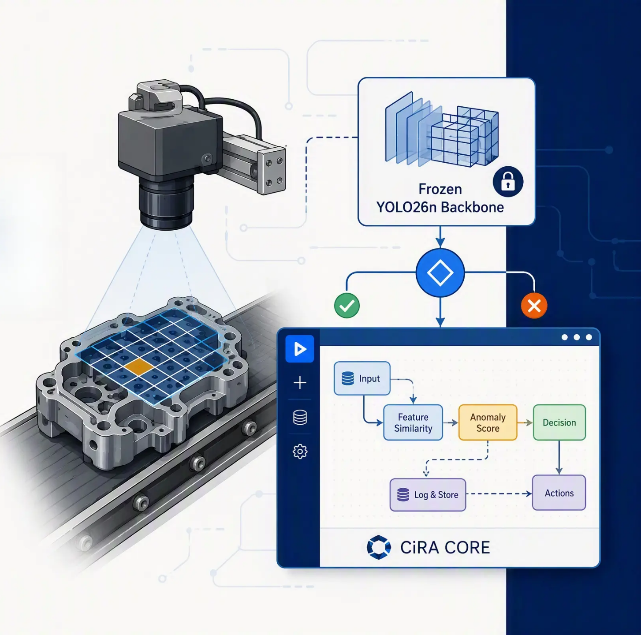


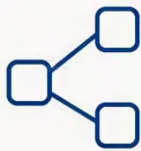
INDUSTRIAL AI PROJECT
Online Test-Time Learning
for Industrial Defect Detection
Using a Low-Code Platform.
Adapting anomaly detectors during inference with
frozen YOLO26n features and CiRA CORE integration.
Frozen YOLO26n
Local Patch Memory
CiRA CORE + Flask

Slide 2






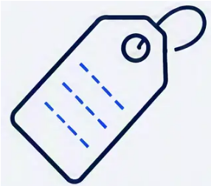

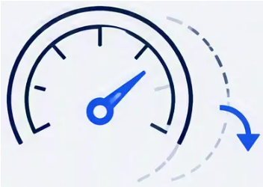


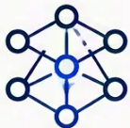

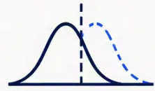







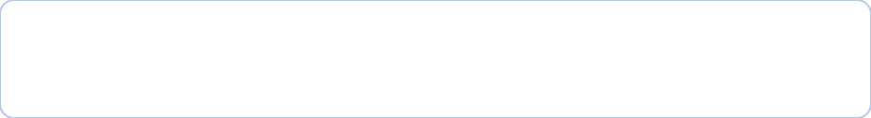

Problem and Motivation
Industrial deployment conditions change after an anomaly detector is released.
Limited defect labels
Distribution shift
Static thresholds
Unsafe online updates
Many normal samples;
future defects may be unseen.
Lighting, alignment, surfaces,
and batches can change.
Offline score boundaries can
trigger false alarms or misses.
A defect accepted as normal
can contaminate future decisions.
Static model
Production shift
Unstable score
boundary
False alarm or
missed defect
Safe online
adaptation
Trusted
updates only
Deployment gap: adaptation must work without labels,
full-model retraining, or unsafe memory updates.

Slide 3


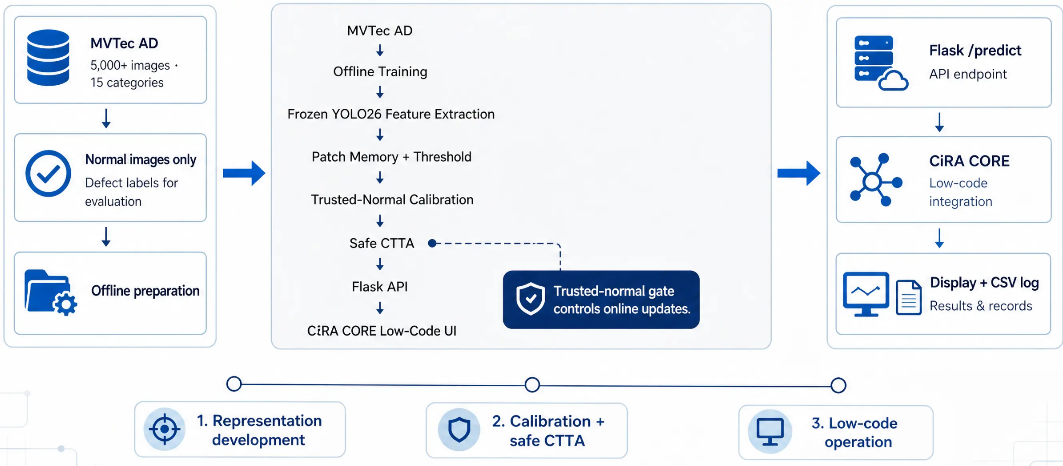


Overall Project Flow
From normal-image reference memory to low-code inspection workflow.

Slide 4

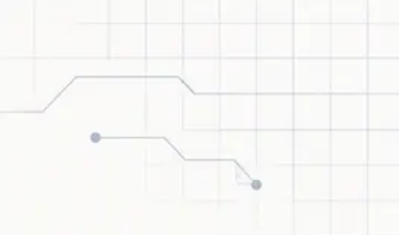


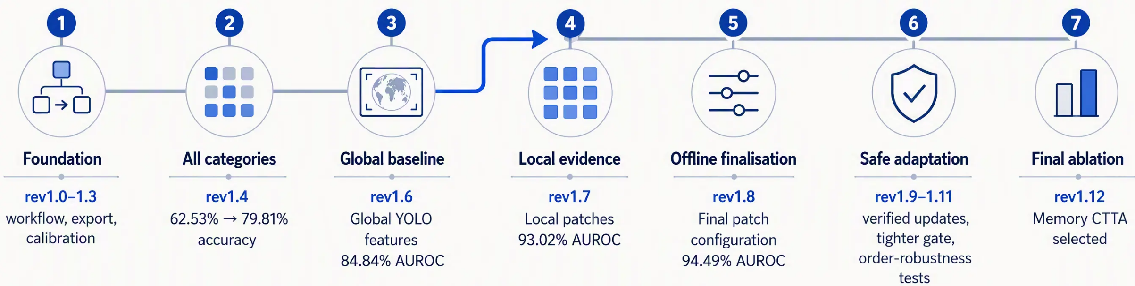



Methodology Evolution
Each revision addressed evidence from the preceding experiment.
SYSTEMATIC EXPERIMENTATION ACROSS 15 CATEGORIES
Final practical winner
Memory CTTA
Best balance of accuracy, Macro F1, and online safety.

Slide 5













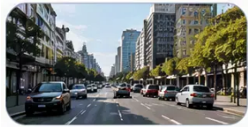

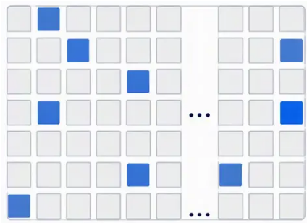

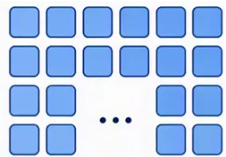
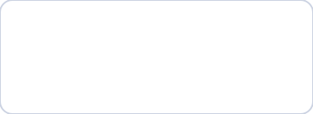


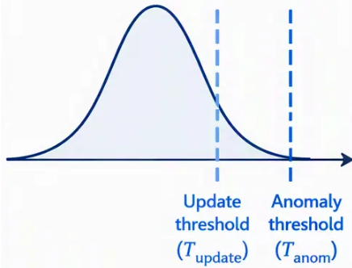
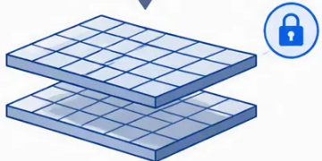

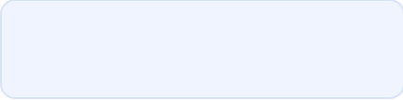




















Core Method and Formulae
Patch-level anomaly scoring and safe online adaptation.
Trusted update gate
Score gate:
Local patch features
Top-K image score
Nearest-normal distance
Trusted-normal calibration
Score distribution
(normal images)
Consistency gate:
weak and strong
views agree
Patch
vector
Normal memory bank
(patch vectors)
AND
Frozen YOLO26n
Top 5% = 10 of 196 patches
d_i = 1 - max cosine similarity
Safe to
update?
S(x) = average of Top-K distances
Anomaly score S(x)
Large distance =
unusual local region
Top-K highest distances
summarize image abnormality
20 trusted-normal
images per category
196 local patches
Yes:
No:
update memory
prediction
only
+ adapter
Frozen backbone:
Patch-level processing:
Memory bank:
Top-K scoring:
Calibrated thresholds:
Dual safety checks:
YOLO26n features
196 local regions
Stores normal patch
Focus on most abnormal
Set using trusted-normal
Prevent contamination
are fixed.
per image.
representations.
local regions.
distribution.
before updating.

Slide 6


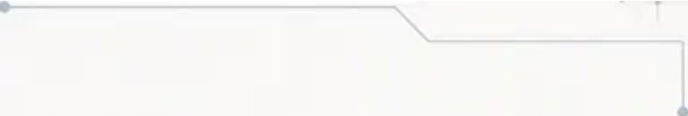
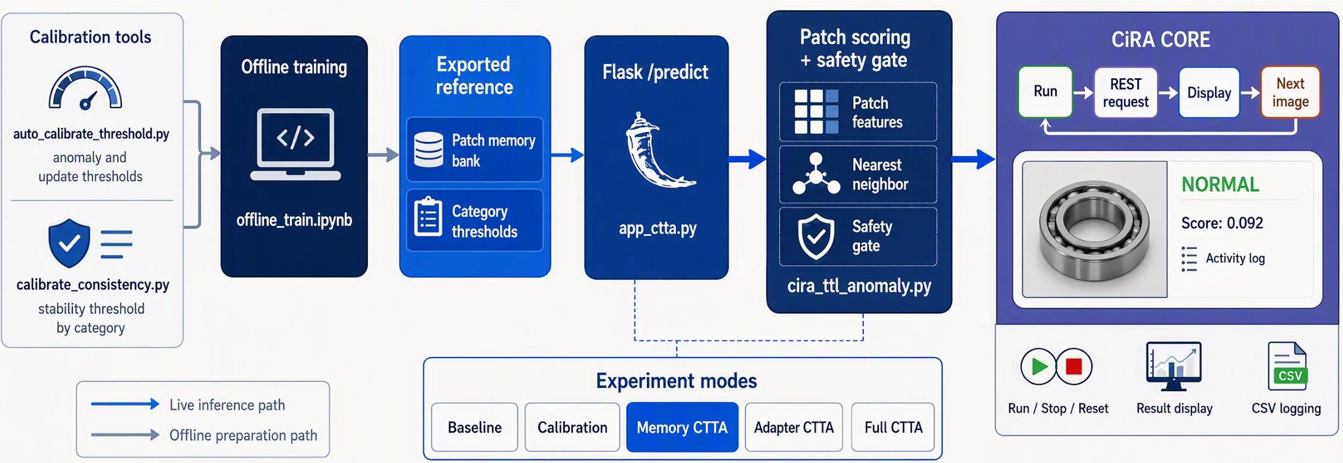






System Implementation
From offline patch-memory preparation to operator-facing low-code monitoring.
Python retains model logic; Flask connects it to the low-code workflow.

Slide 7




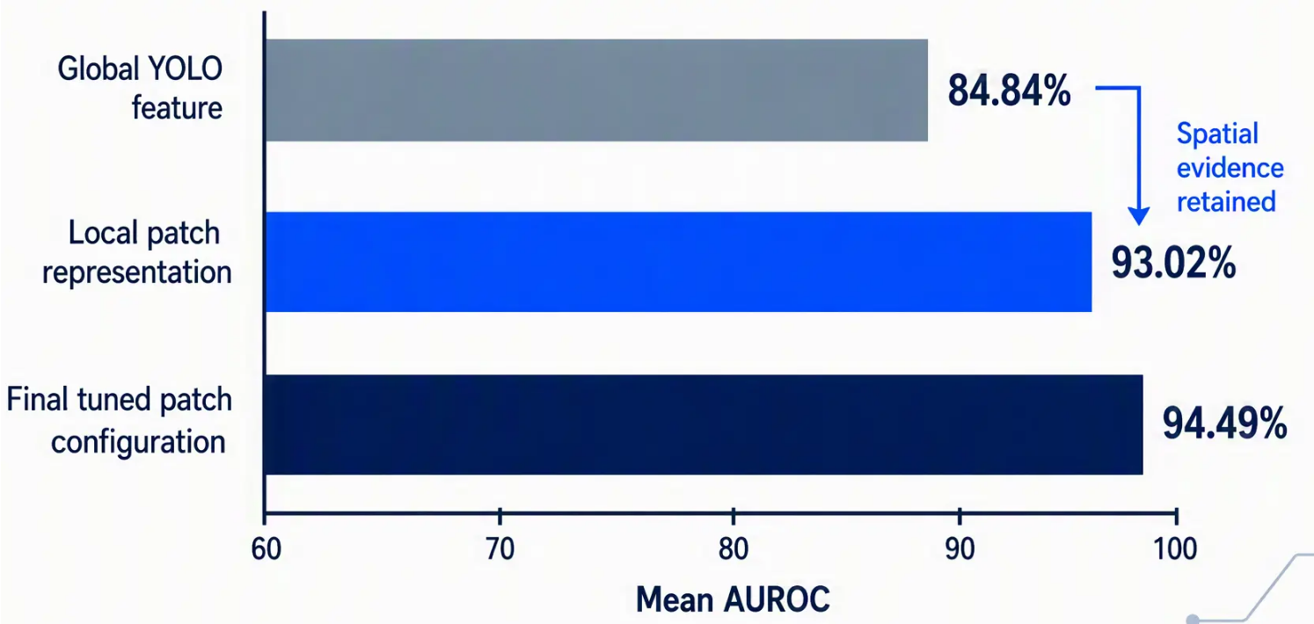
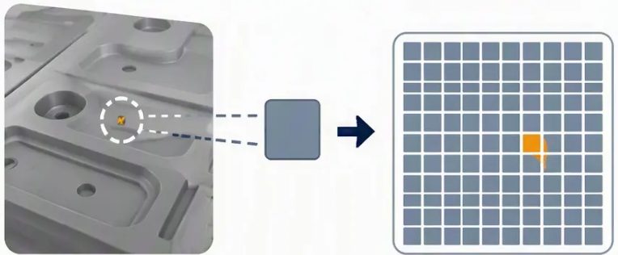








Representation Improvement
+8.18 pp AUROC
Global feature → local patch representation.
Local patch features preserve evidence that whole-image embeddings can average away.
Whole-image
feature (averaged)
Local patch
representation
(14 × 14 grid)
Mean AUROC Progression
Whole-image embeddings can dilute
small defects.
A 14 × 14 grid retains local
visual evidence.
Top-5% scoring focuses on the
most unusual patches.
Final offline accuracy
Macro F1
Normal recall
Anomaly recall
82.36%
84.59%
80.86%
78.42%

Slide 8




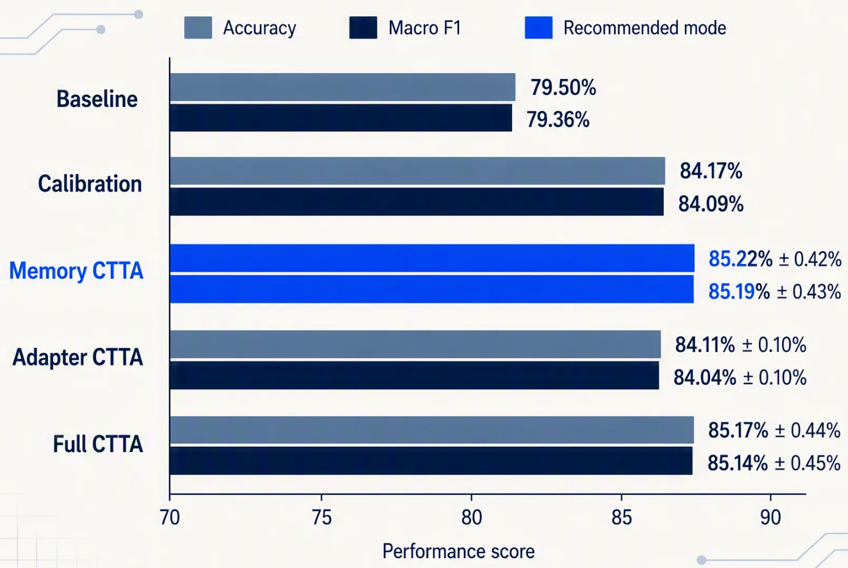






Final Ablation Result
Five deployment modes evaluated across shuffled test streams.
DEFAULT DEPLOYMENT
Memory CTTA delivers the strongest overall balance.
Memory CTTA
85.22%
85.19%
Accuracy
Macro F1
± 0.42%
± 0.43%
Calibration:
Largest deployment gain: +4.67 points
Best overall Accuracy and Macro F1
Simple online state; lower
parameter-drift risk
Full CTTA: best normal recall,
but more defective updates accepted.

Slide 9

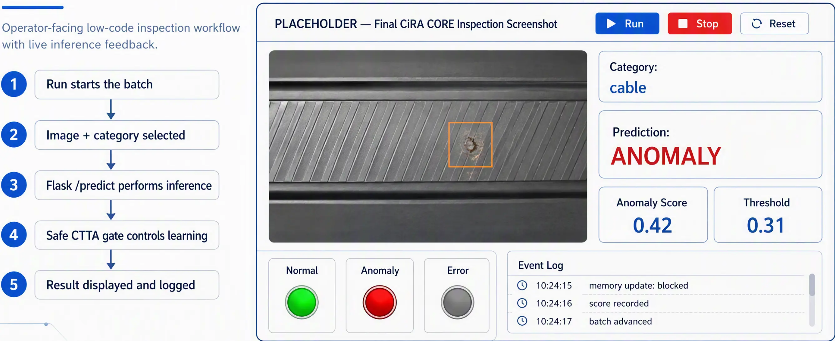
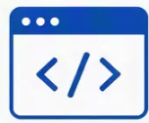
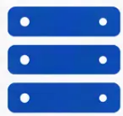
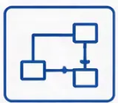



Deployment Demo and CiRA CORE UI
Python
detection logic
Flask
model service
CiRA CORE
visual workflow
CSV logging:
score, gate decision,
memory and adapter changes.

Slide 10

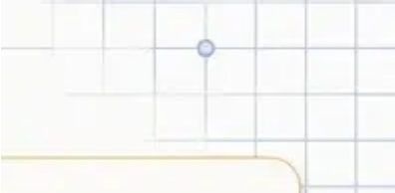





























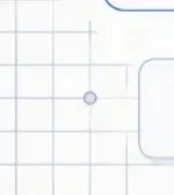

Conclusion, Limitations, and Future Work
A practical online adaptation path, with clear safeguards still to strengthen.
Current limitations
Defective samples can still enter the update path
Tested on short shuffled streams only
MVTec AD image-level validation;
no live production integration
Deploy Memory CTTA by Default.
Priority future work
Best balance of Accuracy and Macro F1
Simple, controlled online state
Filter contamination at patch level
Lower parameter-drift risk
Select representative patches with an online coreset
No YOLO26n retraining required
Test long-duration drift and recovery
Frozen
trusted-normal
gate
normal memory
update
Add human confirmation for uncertain
updates in CiRA CORE
local features
Memory CTTA is the strongest deployment choice today; safer memory selection is the next critical step.

